Slide 1
Decolonising: An Introduction
Dr Sonali Misra | May 2025

Slide 2
      What do you understand by the terms ‘postcolonialism’, ‘neocolonialism’, ‘decolonising’?

Slide 3
Colonialism
      Practice of domination involving subjugation of one people to another
      In European colonialism, can be seen as settlement of Europeans, violent dispossession and political domination over rest of the world including Americas, Australia, parts of Asia and Africa
      Historically, done for different reasons or rationales:
        economic
        religious
        political and strategic
        ‘scientific’
        – and these rationales led to a binary of civilised/uncivilised, blessed by God/not blessed, intelligent/unintelligent, rational/mystical

Slide 4
Imperialism
      Variations in literature in how people perceive colonialism vs imperialism
      Some use it interchangeably
      Some regard colonialism as involving settlement (US, Australia) vs imperialism as governing without significant settlement (India, Puerto Rico)
      Root of ‘colony’ – Latin colonus – farmer
      Root of ‘imperialism’ – Latin imperium – to command

Slide 5
Hegemony
      Dominance of one group over another, often by legitimising certain ideas and norms
      From Greek hēgemonia – dominance over, used to describe relationship between city states
      Today often used to describe relatively dominant position of a particular set of ideas and their associated tendency to become commonsensical and intuitive
      Italian politician and Marxist philosopher Gramsci examined class rule in capitalist societies and stated it was through consensual means
      Same theory can be applied within international political economy with the economic, political, and social structures that facilitate particular patterns of production within the world economy

Slide 6
Postcolonialism
      Hyphenated post-colonialism implies the condition begins after colonialism ends
      But many scholars use without hyphen ‘on the grounds that the postcolonial condition is inaugurated with the onset rather than the end of colonial occupation’ (Gandhi 1998, p 3)
      Usually used with regards to nations colonised by land and politically
      Colonised’s predicament – complex relationship in which the colonised longs for the coloniser, being ‘shaped and troubled by the compulsion to return a voyeuristic gaze upon Europe’ (Gandhi 1998, p 11)

Slide 7
Neocolonialism
      ‘Neo’ – new
      Not always easily differentiated from postcolonialism as many of the colonial powers (US, UK) having a postcolonial impact are now also neocolonial powers
      Control of less-developed countries (Global South) by developed countries (West and Global North) through indirect means – military, political, economic, cultural. Can be concealed, or half-concealed.
      Think of the power of US finance capital and huge multinationals to direct flow of capital, commodities, armaments and media information
      Examples:
        impact of Trump’s tariffs across different countries’ economies
        dominance of UK and US media and publishing in Anglophone world

Slide 8
Decolonisation/Decolonising
      Decolonisation: process by which colonies become independent of colonial powers
      Decolonising: dismantling colonial structures and systems, both politically and culturally
      Decolonising especially key for cultural imperialism – the privileging of one culture over another (literature and other media, knowledge, cultural beliefs and practices)

Slide 9
      All parties seem to be agreed on one point, that the dialects commonly spoken among the natives of this part of India, contain neither literary nor scientific information, and are, moreover, so poor and rude that, until they are enriched from some other quarter, it will not be easy to translate any valuable work into them. It seems to be admitted on all sides, that the intellectual improvement of those classes of the people who have the means of pursuing higher studies can at present be effected only by means of some language not vernacular amongst them.
      What then shall that language be? One-half of the Committee maintain that it should be the English. The other half strongly recommend the Arabic and Sanscrit. The whole question seems to me to be, which language is the best worth knowing?
      I have no knowledge of either Sanscrit or Arabic. But I have done what I could to form a correct estimate of their value. I have read translations of the most celebrated Arabic and Sanscrit works. I have conversed both here and at home with men distinguished by their proficiency in the Eastern tongues. I am quite ready to take the Oriental learning at the valuation of the Orientalists themselves. I have never found one among them who could deny that a single shelf of a good European library was worth the whole native literature of India and Arabia. The intrinsic superiority of the Western literature is, indeed, fully admitted by those members of the Committee who support the Oriental plan of education.’
                – Lord Macauley’s Minute on Indian Education, 1835

Slide 10
Decolonising in Education and Media
      Think of academia, research, literature – privileging of Global North/the West in terms of funding, publication, distribution, respect, notions of ‘legitimacy’ – an extension of the West/East binary in colonisation
      Decolonising the curriculum, research, library collections happening across the world
      Does not mean removal of Western texts and knowledge, but engaging with them in a critical manner + expanding knowledge bases to include other POVs

Slide 11

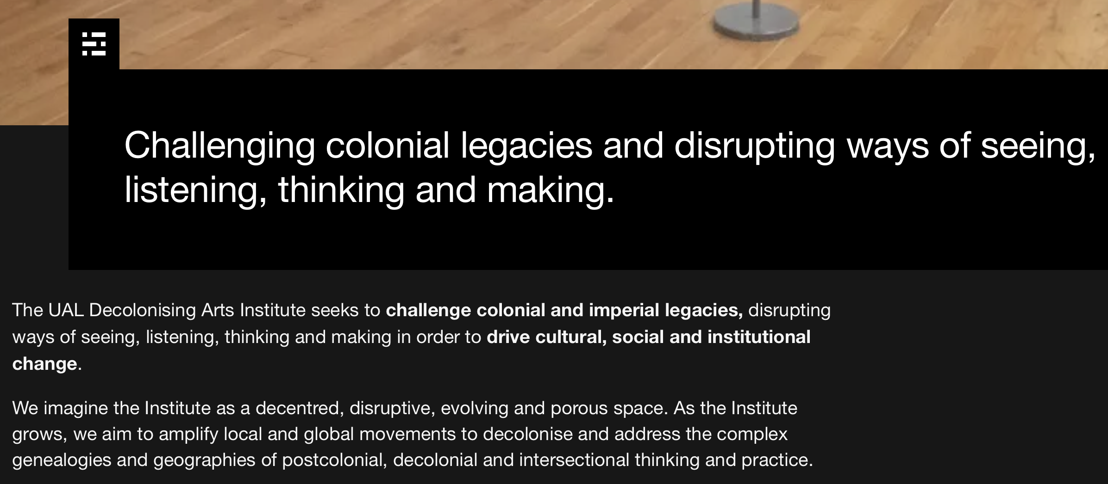
Decolonising in Education and Media

Slide 12
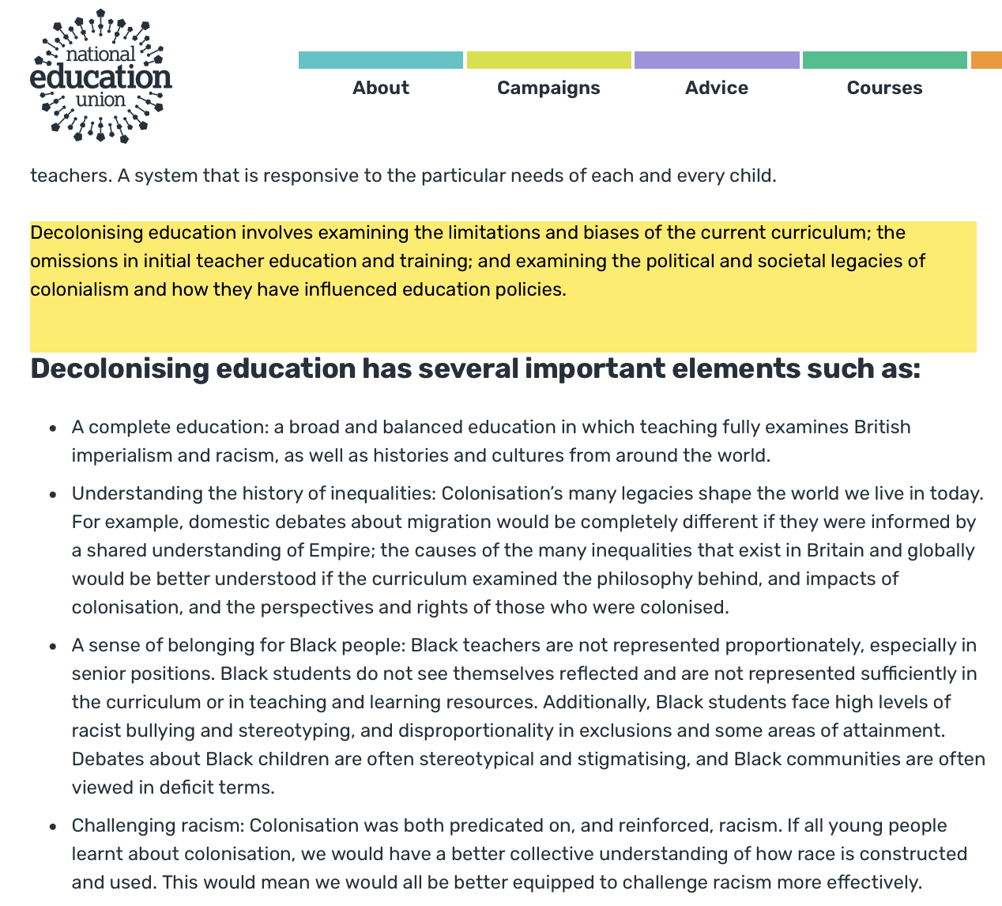
Decolonising in Education and Media

Slide 13
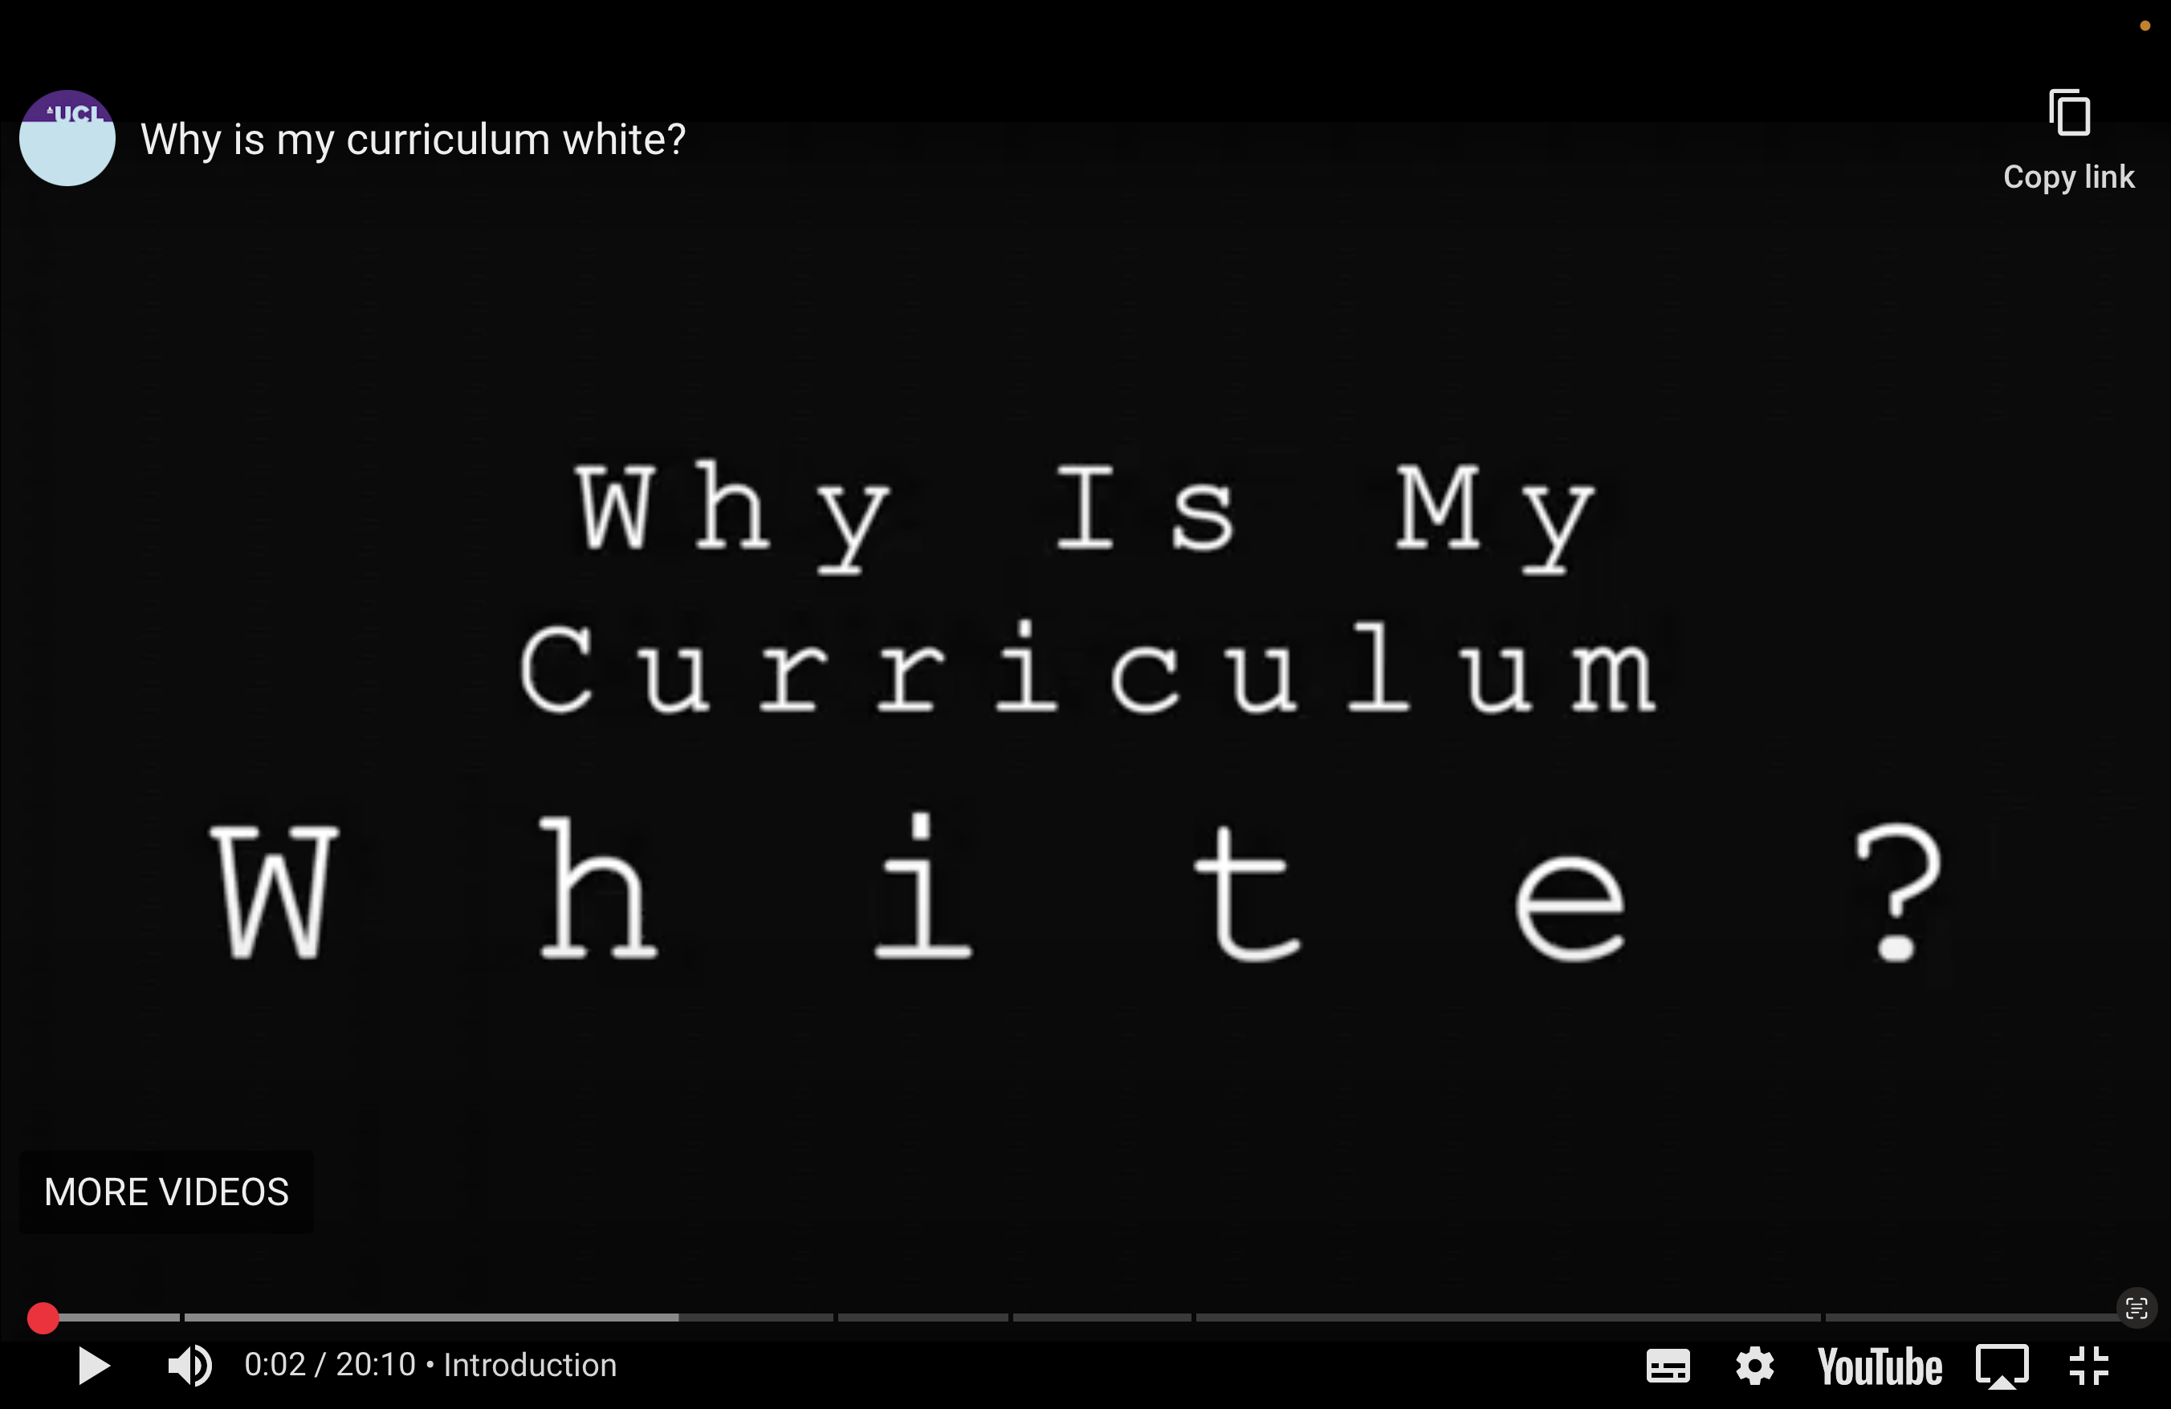
Decolonising in Education and Media
https://www.bameednetwork.com/resources/video/why-is-my-curriculum-white/

Slide 14
Further reading: articles and resources
https://www.arts.ac.uk/ual-decolonising-arts-institute
https://www.bera.ac.uk/publication/the-bera-guide-to-decolonising-the-curriculum
https://www.theguardian.com/us-news/2020/jun/11/only-fifth-of-uk-universities-have-said-they-will-decolonise-curriculum
https://www.theguardian.com/education/2019/mar/20/academics-its-time-to-get-behind-decolonising-the-curriculum
https://neu.org.uk/advice/equality/race-equality/decolonising-education

Slide 15
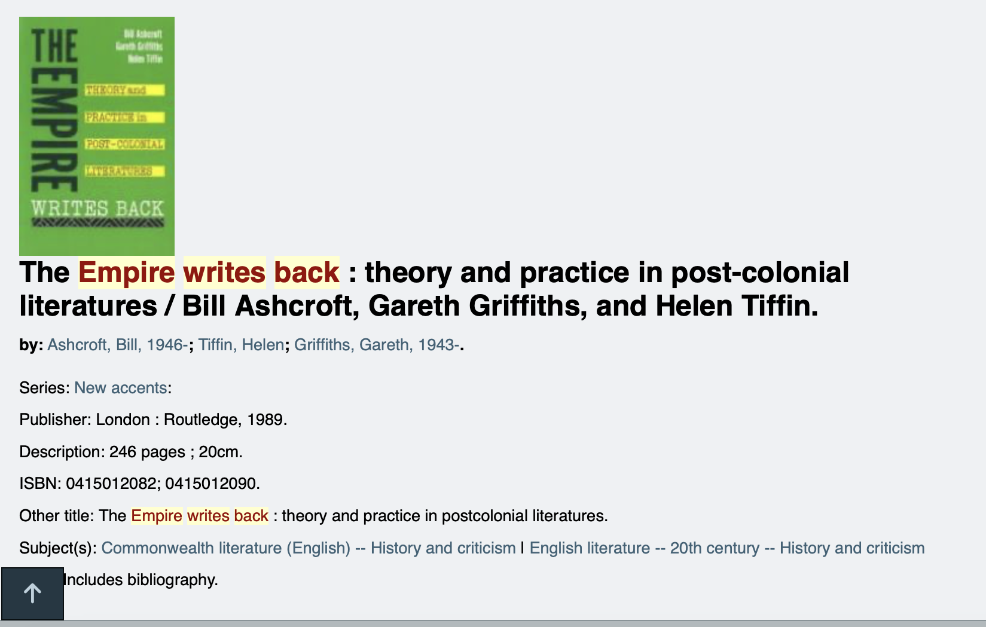
Further reading: books

Slide 16
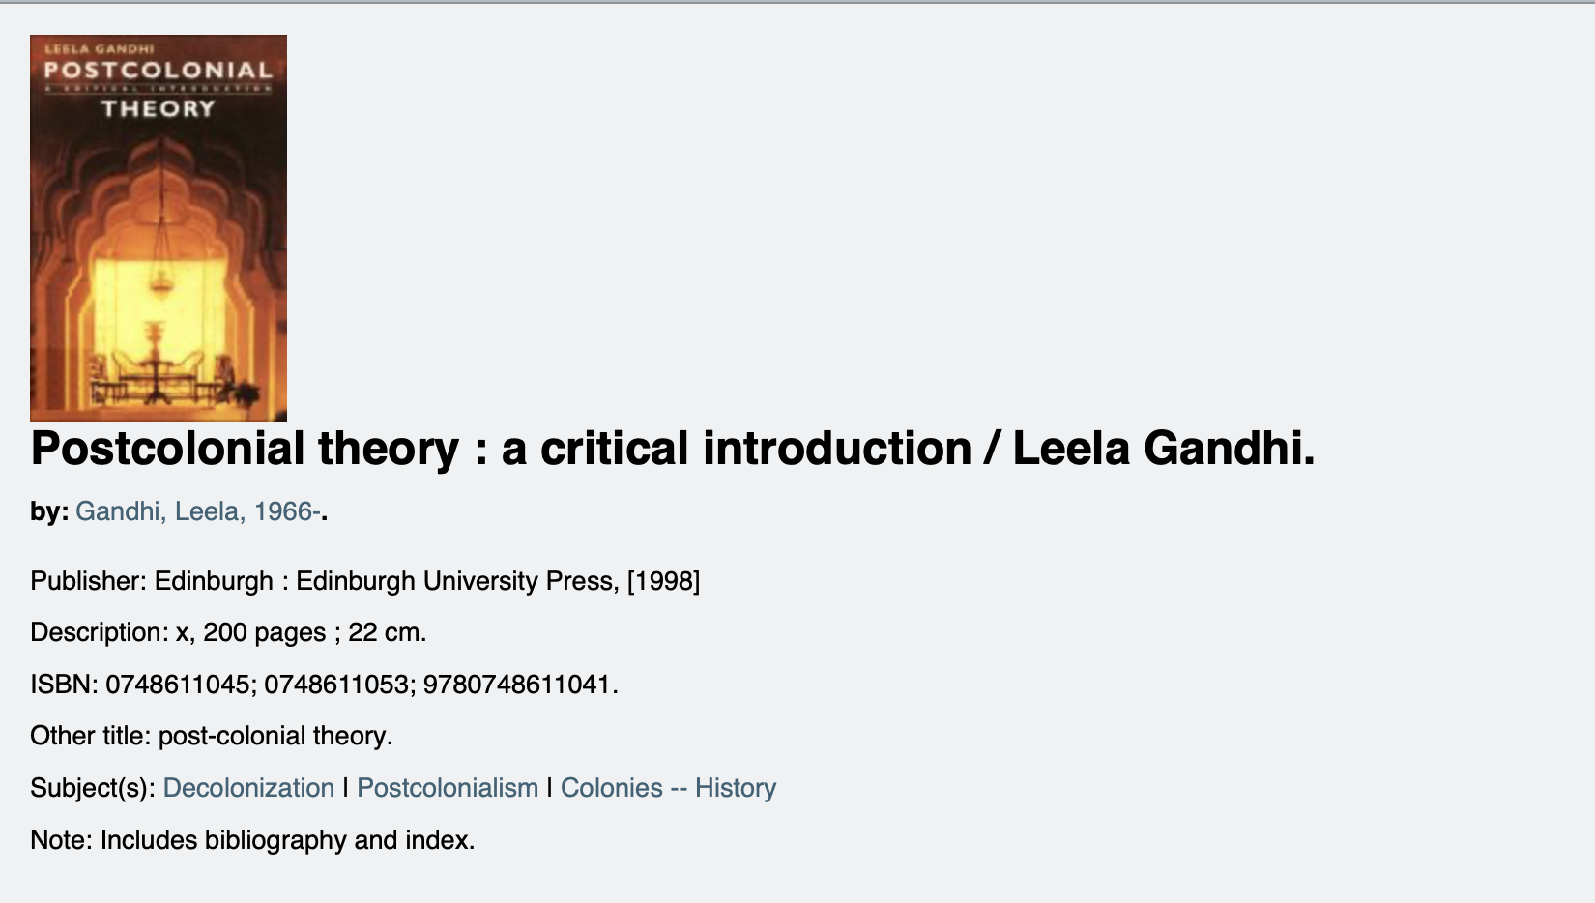
Further reading: books

Slide 17
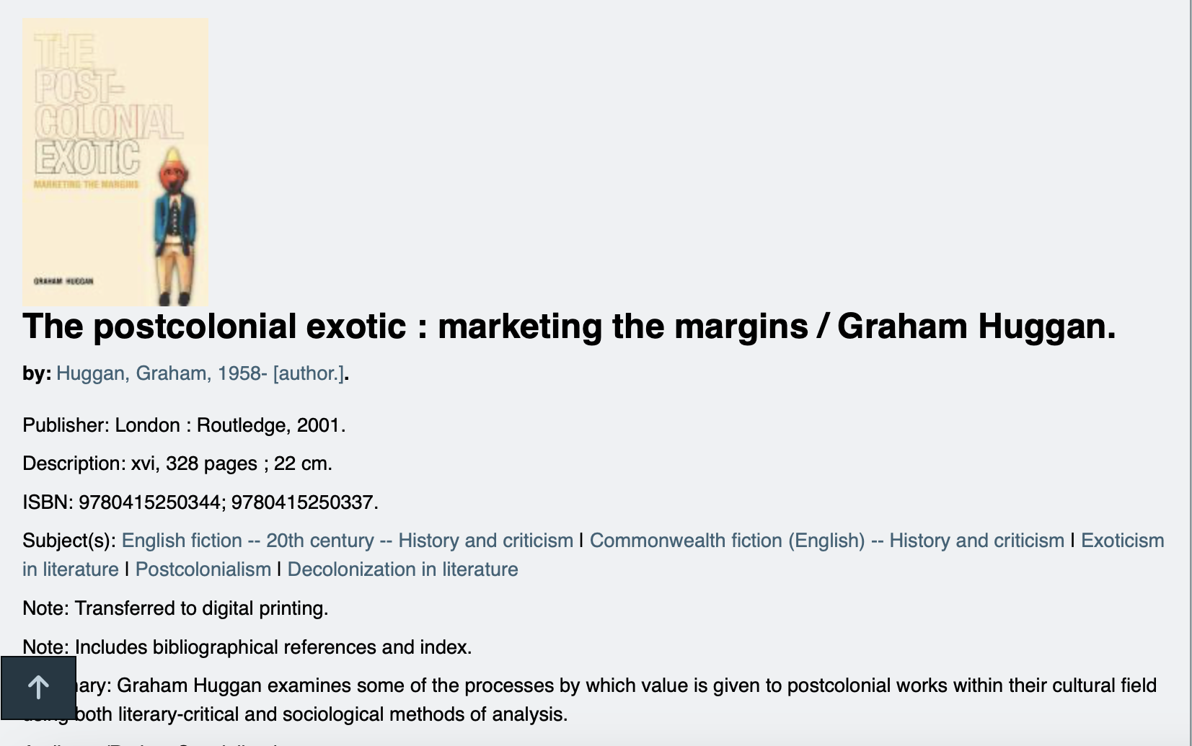
Further reading: books

Slide 18

Further reading: books

Slide 19
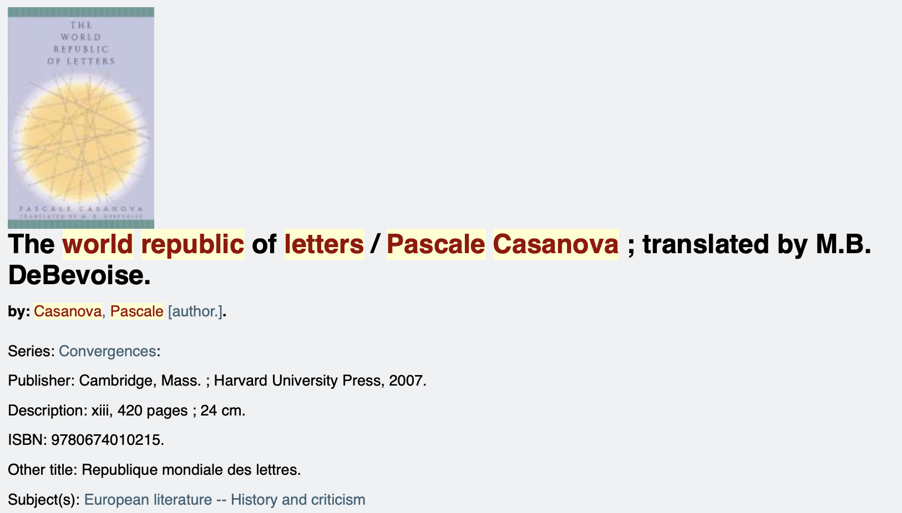
Further reading: books

Slide 20
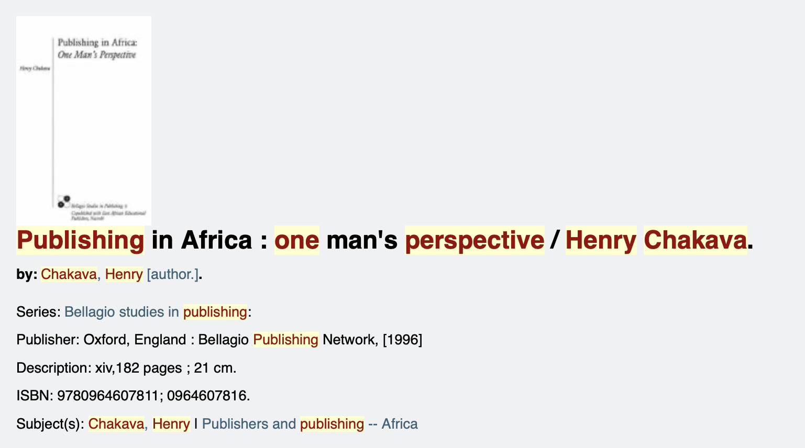
Further reading: books

Slide 21
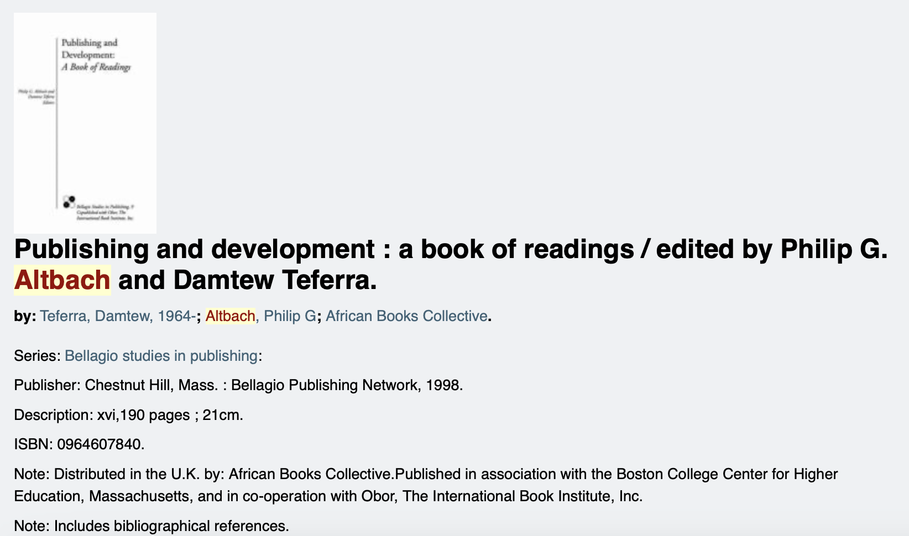
Further reading: books

